Slide 1
SUFIYAN & DEVEN & SATYANSH
PRESENTS
AI VS HUMAN-GENERATED IMAGES
Proliferation of Deep‑Fake Imagery Threatens Trust in News, IP Ownership, And Social Media Authenticity
CS 663 • Spring 2025
Slide
1
Notes:
Sufi - Hello everyone! My name is Sufiyan, and together with my teammates Deven and Satyansh, we're excited to share our project: AI vs Human-Generated Images.
Our goal behind this project was to find a reliable way to tell apart images made by humans from those generated by artificial intelligence. With the rise of deepfakes and AI-generated content, it’s becoming harder to trust what we see online.
Today, we'll briefly explain why this matters, how we built our AI detector using deep learning, and share some interesting results we found.

Slide 2
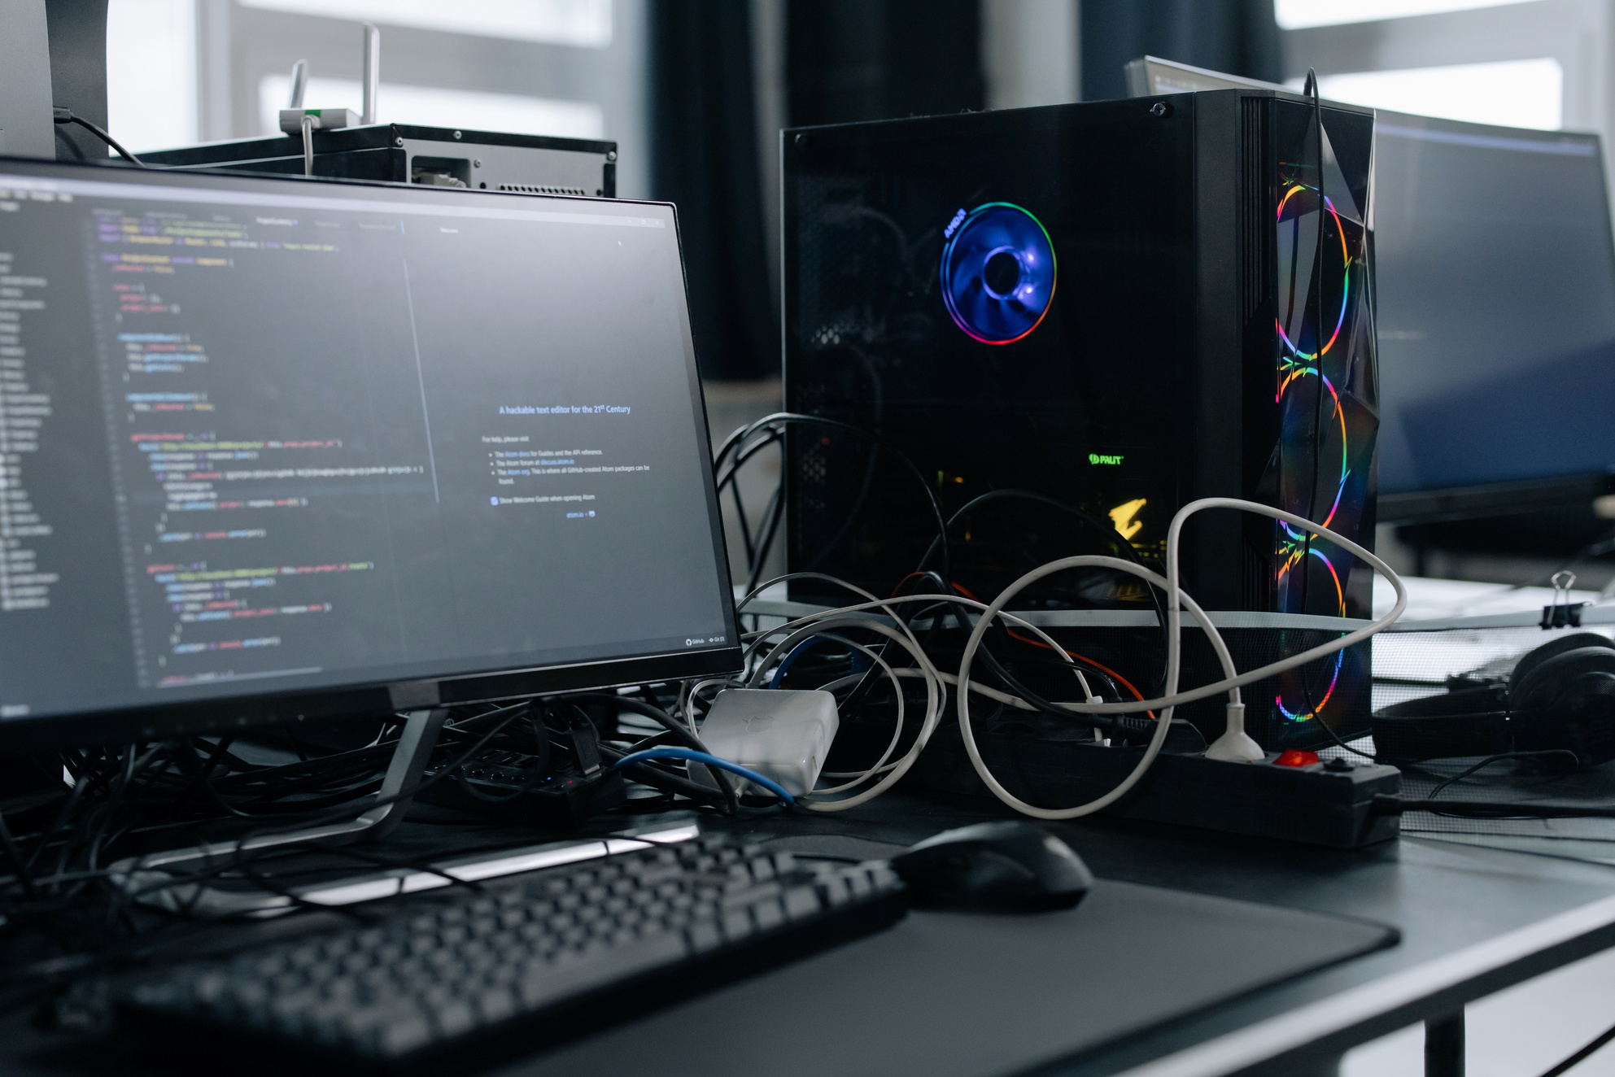
Agenda
Goal & motivation
Prior work & challenges
Dataset & EDA
Models → CNN ▸ ResNet-18 ▸ EfficientNet-B0
Training & tuning
Results and takeaways
Limitations, future work
Slide
2
Notes:
Sufi - Here's our agenda for today. We'll start with the goal and motivation of this project, then cover some related work and the challenges in this field. After that, we will describe the dataset we used and some initial exploration we did. The core of the talk will be about the models: first, a baseline CNN, then two transfer learning models (ResNet-18 and EfficientNet-B0), and how we trained and tuned them. Finally, we'll present the results we got, discuss what they mean (takeaways), and acknowledge the limitations and possible future work.

Slide 3
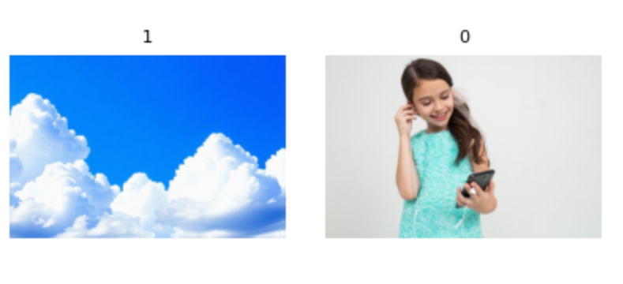
Project Goal
Objective: binary classifier (AI vs Human)
Target > 95 % accuracy on unseen data
End-users: journalists, social-media mods, IP owners
Deliverable: Colab pipeline + Kaggle submission file
Slide
3
Notes:
Sufi - Our goal is to build a classifier that can tell if an image is AI-generated or human-made. We set a high target of over 95% accuracy on unseen images because we want the model to be very reliable. This tool is meant for people like journalists verifying photos, social media moderators catching fake images, or content creators worried about their work being copied. In terms of output, we're providing a complete Colab pipeline for the model and a Kaggle submission file with its predictions.

Slide 4
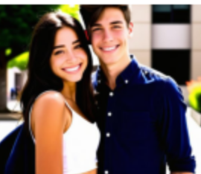
Why This Matters
Deep-fake images threaten trust & news integrity
Platforms need automatic flags for suspicious images
Helps curb misinformation & protect creators
Encourages responsible generative-AI use
Slide
4
Notes:
Sufi - The reason this project matters is because deepfake images and AI-generated content are starting to erode trust. People might see fake photos in the news or online and believe them, which can spread misinformation. So, platforms really need an automated way to flag potentially fake images to help moderators out. A good detector can help stop false information from going viral and also protect artists and photographers, because it can catch if someone is using AI to imitate their work. Ultimately, having detection in place also pushes for more responsible use of AI – if everyone knows fakes can be caught, there's less incentive to misuse the technology.
This project matters because deep fake images created by AI—often called deepfakes—are making it harder to trust what we see online. People might believe these fake images, leading to misinformation spreading quickly. Platforms need automated tools to identify these fake images and support moderators. A good detector can prevent false information from going viral and protect artists and photographers by catching attempts to imitate their work with AI. Ultimately, effective detection encourages responsible use of AI—if people know fakes can be spotted, they're less likely to misuse this powerful technology.

Slide 5
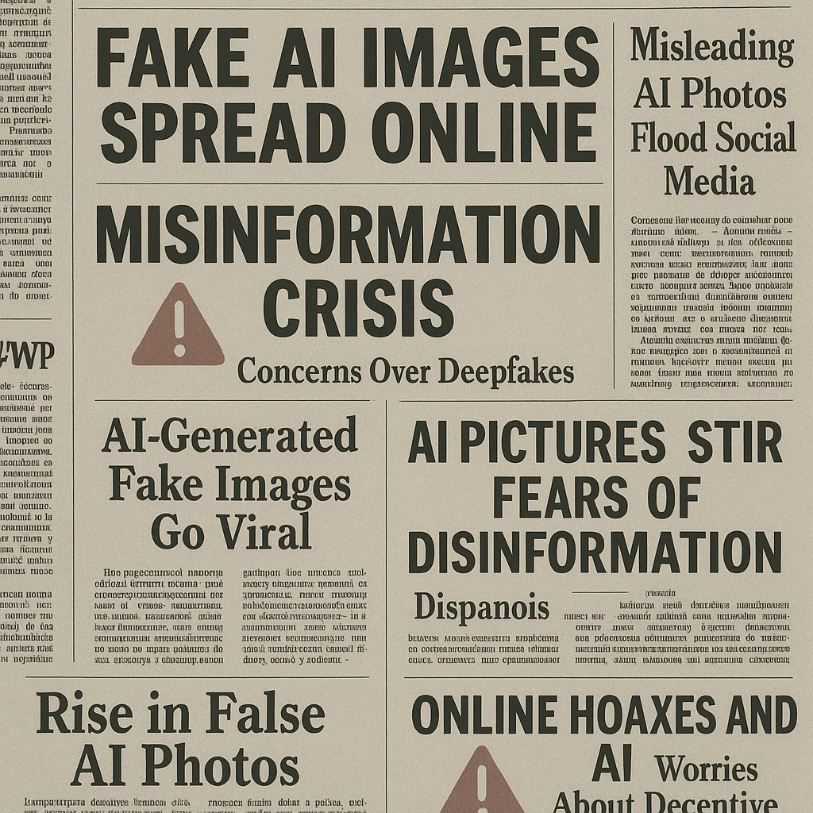
Background / Related Work
• Early CNN steganalysis on pixel artifacts (2019-2022)
• Transfer-learning boom: ResNet / EfficientNet on deepfakes
• New trend: Vision Transformers for global context
• Arms-race: SD-XL Turbo, DALL·E 3 shrink detectable artifacts
Slide
5
Notes:
Satya - In terms of related work, earlier efforts (around 2019–2022) used CNNs to perform a kind of steganalysis – basically looking for hidden pixel-level artifacts that might reveal an image is AI-made. Then came the transfer learning boom where people fine-tuned big pre-trained models like ResNets and EfficientNets on deepfake datasets, which significantly improved detection accuracy. The latest research trend is exploring Vision Transformers, which can capture global image relationships better and might catch things CNNs miss. And it's worth noting this is an arms race: as detectors improve, AI generators also evolve. The newest image generators (like Stable Diffusion XL or DALL·E 3) produce more realistic images with fewer obvious artifacts, making the detection job increasingly challenging.

Slide 6
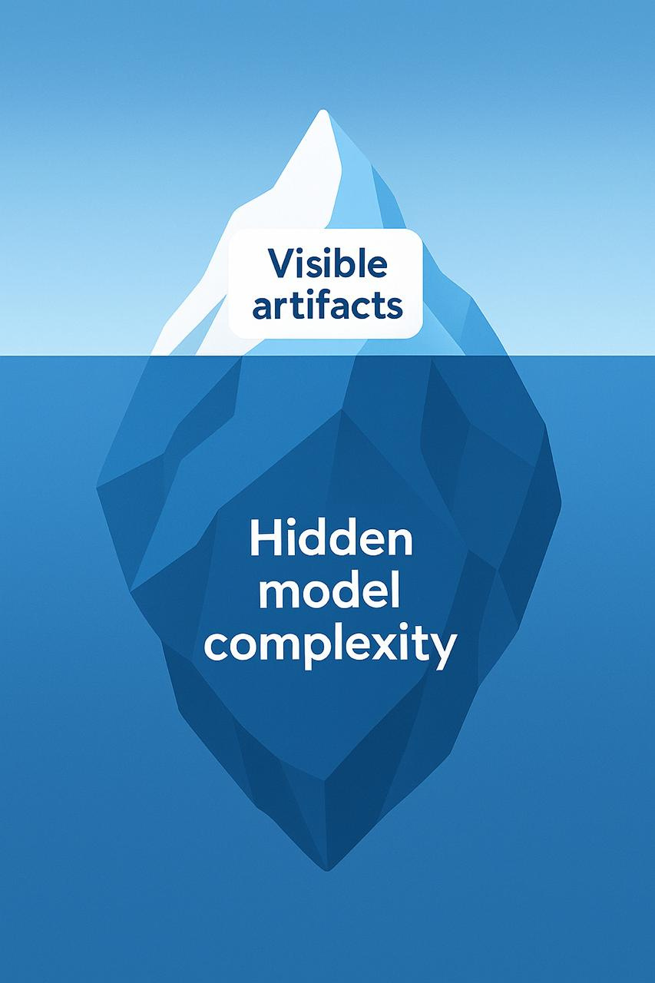
Data Overview
Source:
Size:
Format:
Pre-Checks:
Splits:
Augment:
Kaggle“AI‑vs‑Human Images” (2025)
84,774 images – 50 % real / 50 % AI
RGB PNG/JPEG, 256–512 px
Files in train.csv in Train folder and same for test.csv
80 / 20 stratified
crop, flip, ±10° rotate
Slide
6
Notes:
Satya - We used the Kaggle "AI vs Human Images" dataset (released in 2025). It has about 84,774 images total, perfectly balanced half real and half AI-generated. The images are standard JPEG/PNG files, mostly in the resolution range of 256 to 512 pixels. We did some pre-checks on the data: for example, we verified file integrity of train.csv and test.csv. After cleaning, we split the data into 80% training, 20% validation, and used test folder images for testing. We also planned on applying some data augmentation during training – things like random crops, flips, and slight rotations – to enrich the training data and help the model generalize.

Slide 7

• 80 / 20 stratified train-val split
• Standardize to 224 × 224, RGB, ImageNet μ/σ norm
• Augmentations: crop, flip, ±10° rotate
• Manual spot-check: no obvious giveaways; need model-level cues
Data Prep & EDA
Slide
7
Notes:
Satya - For data preparation, we standardized everything for our models. Every image was resized to 224×224 pixels and converted to three channels (RGB). We also normalized the pixel values using the standard mean and std from ImageNet, since our pre-trained models expect that scaling. As mentioned, we applied augmentations like flips, rotations, and random crops on the fly during training to make the model more robust. We also did a quick exploratory analysis: basically looking at samples of the data. We didn’t find any obvious visual giveaways distinguishing AI images from real ones – no big watermark or glaring artifact that a person could easily spot. This told us that the differences are likely subtle and that the model would have to pick up on small cues to do well.

Slide 8
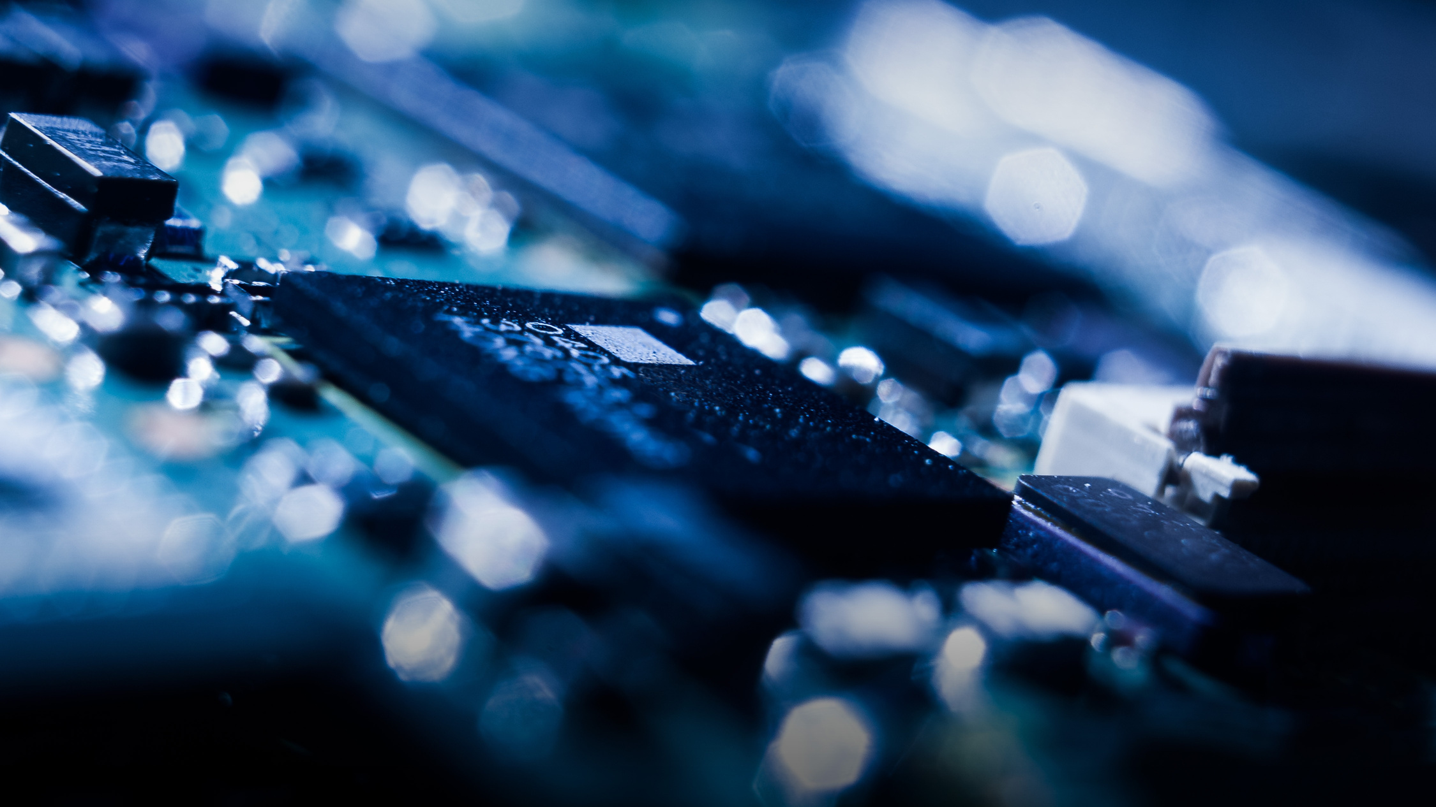
Methodology Snapshot
Baseline scratch CNN
Transfer-learn ResNet-18 & EfficientNet-B0
Iterative tuning via val set, early-stop patience 2
Best model → Kaggle submission
Slide
8
Notes:
Satya - Our methodology was as follows. We started with a baseline CNN that we built and trained from scratch, just to set a reference point. Then we moved on to transfer learning using two models: ResNet-18 and EfficientNet-B0, which came pre-trained on ImageNet. We fine-tuned those on our dataset to see if we could improve performance. We used an iterative tuning approach – training the model and checking against the validation set, then adjusting hyperparameters and even which layers we fine-tuned, step by step. We also used early stopping (with a patience of 2 epochs) to avoid overfitting. In the end, we took our best-performing model and used it to generate a Kaggle submission on the test set to evaluate it on test data.

Slide 9

Tech Stack
• PyTorch + Torchvision pretrained weights
• Training in Google Colab (T4 & limited A100)
• AMP mixed-precision for speed
• Torchmetrics & scikit-learn for stats/plots
Slide
9
Notes:
Deven - For the tech stack, we used PyTorch for implementing our neural networks, and Torchvision to leverage pre-trained models like ResNet-18 and EfficientNet-B0. We trained our models on Google Colab – mostly on a T4 GPU (we even briefly used an A100 when available, which sped things up). We turned on mixed-precision training (Automatic Mixed Precision) to make the training faster and more memory-efficient by using half-precision where possible. And for evaluating results and creating plots, we relied on Torchmetrics (for metrics like accuracy, F1, etc.) and some scikit-learn tools for things like ROC curves and confusion matrices.

Slide 10
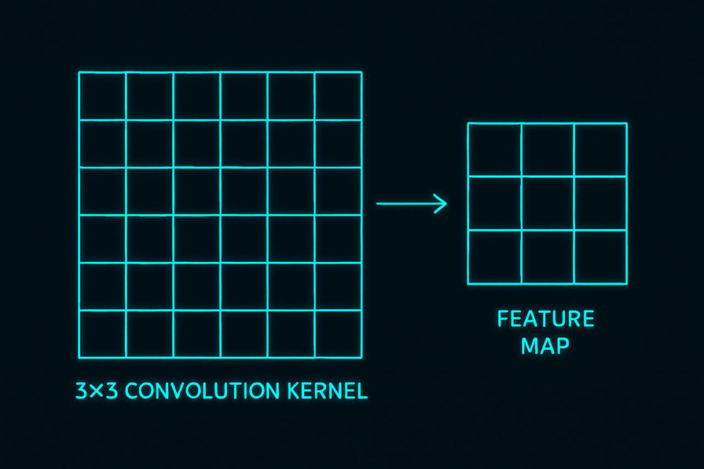
CNN (1/2) — What is a CNN?
• Convolution layers learn local patterns (edges, textures)
• Weight sharing ↓ parameters vs dense nets
• Pooling layers give translation invariance
• Suitable baseline to gauge dataset difficulty
Slide
10
Notes:
Deven - So, what's a CNN, and why did we start with it? A Convolutional Neural Network is a type of model that is really good at processing images by looking for small patterns and building up from there. It uses convolution layers, which you can think of as small filters that scan over the image and pick out local features – for example, one filter might detect an edge or a texture. Importantly, the same filter is used across the whole image (that's called weight sharing), which dramatically reduces the number of parameters compared to a fully connected approach, and it helps the model learn efficiently. CNNs also typically include pooling layers after convolutions. Pooling basically downsamples the image representation, making the model a bit invariant to translations – in plain terms, if an object in the image moves a little, the pooled feature still captures it. Because CNNs focus on local patterns and use these efficiencies, they were a natural choice as our baseline model. We wanted to see how a straightforward CNN would perform on our dataset as an initial gauge of the problem's difficulty.

Slide 11
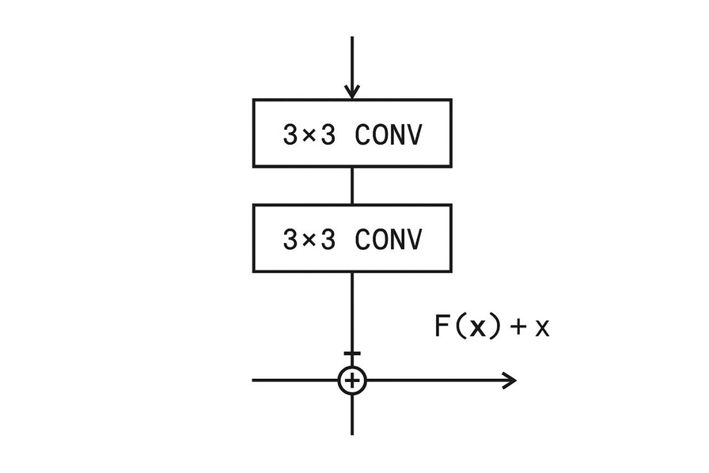
CNN (2/2) — Our Architecture
• 4 × [Conv 3×3 → BN → ReLU → MaxPool]
• Global Avg Pool → FC(512→2) softmax
• ~2 M parameters, 9 layers deep
• AdamW 1e-3, batch 256, 10 epochs + early stop
Slide
11
Notes:
Deven - Now let me outline our CNN architecture. We built a simple stack of four convolutional layers. Each conv layer used a small 3×3 filter and was followed by a Batch Normalization step and a ReLU activation to keep the training stable and non-linear, and then a Max Pooling layer to reduce the spatial size. After these 4 convolution+pooling blocks, we applied a Global Average Pooling layer, which essentially takes the average of each feature map from the last conv layer. This gives us a compact feature vector that we feed into a fully connected layer. That final dense layer outputs two numbers (one for "AI" and one for "Human"), and we apply softmax to get probabilities. This whole network ended up with about 2 million parameters in total and is roughly 9 layers deep if you count each conv and the final FC. We trained it from scratch using the AdamW optimizer with a learning rate of 1e-3. We used a batch size of 256 and trained for up to 10 epochs, stopping early if the validation accuracy stopped improving.

Slide 12
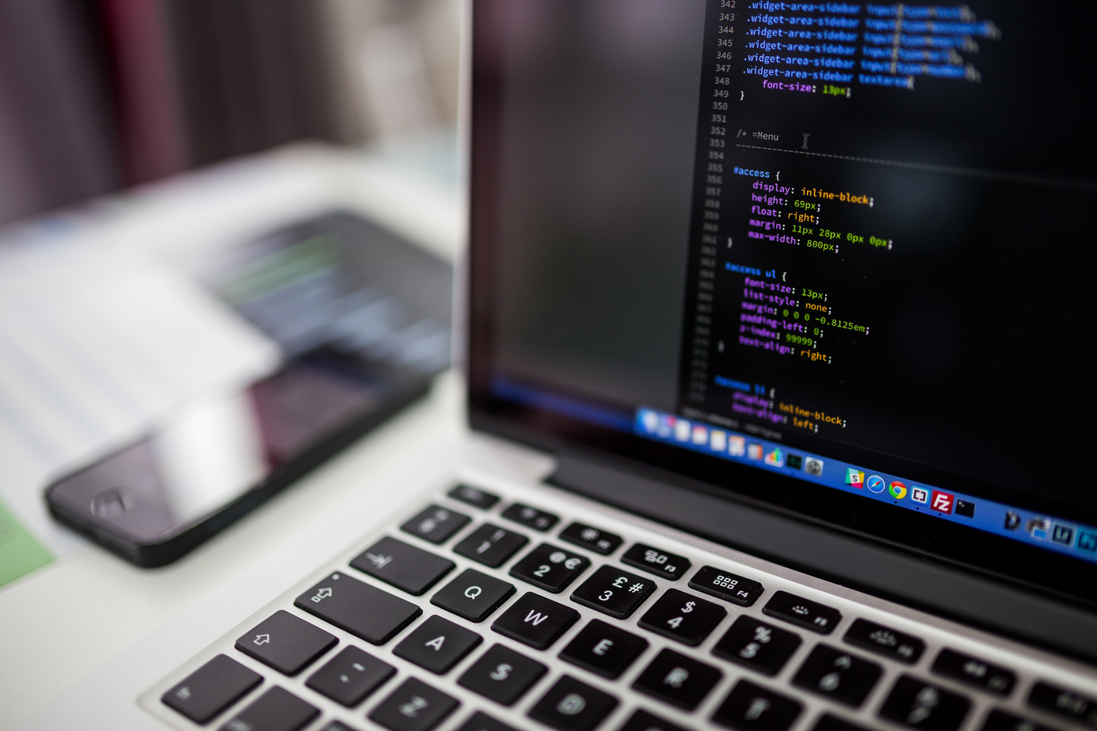
CNN Training & Augment Impact
• No-aug model overfit → 88-89 % val acc
• Added crop/flip/rotate → ↑ to ~93 %
• Aug reduced train-val gap by 4 pp
• Confusion: more FP than FN (model “plays safe”)
Slide
12
Notes:
Deven - How did our CNN actually do, and what difference did data augmentation make? Initially, we trained the CNN without any augmentation and found it started to overfit the training data. Its validation accuracy plateaued around 88–89%, which was a bit disappointing. Then we introduced those augmentations (random crops, flips, and rotations) during training. With augmented data, the model's validation accuracy jumped up to around 93%. Basically, the extra distorted images helped the CNN generalize better, closing the gap between training and validation performance by a notable margin (roughly a 4% improvement in val accuracy). We also analyzed the types of errors it made. The CNN tended to produce more false positives than false negatives – meaning it sometimes incorrectly flagged real images as AI-generated. It was sort of "playing it safe" by being quick to call something fake. This was an interesting bias in the baseline model's behavior.

Slide 13
Baseline Results
• Val accuracy ≈ 93 % | F1 ≈ 0.93
• ROC-AUC 0.96 – good separability
• Need higher-capacity model ⇒ transfer learning
Slide
13
Notes:
Sufi - To summarize the baseline CNN's results: it reached about 93% accuracy on the validation set, with an F1 score roughly the same (0.93). We also looked at the ROC curve; the AUC was around 0.98, which indicates the model had pretty good discrimination between the two classes overall. However, 93% accuracy still means it was getting quite a few images wrong. For example, if our validation set of about 8,500 images, it misclassified roughly 600 of them. That's not great if you imagine those errors happening in a real-world scenario. So, clearly the baseline had room for improvement. This told us we likely needed a higher-capacity model – something more powerful – to push the accuracy higher. That's why we decided to try transfer learning with larger pre-trained networks next.

Slide 14
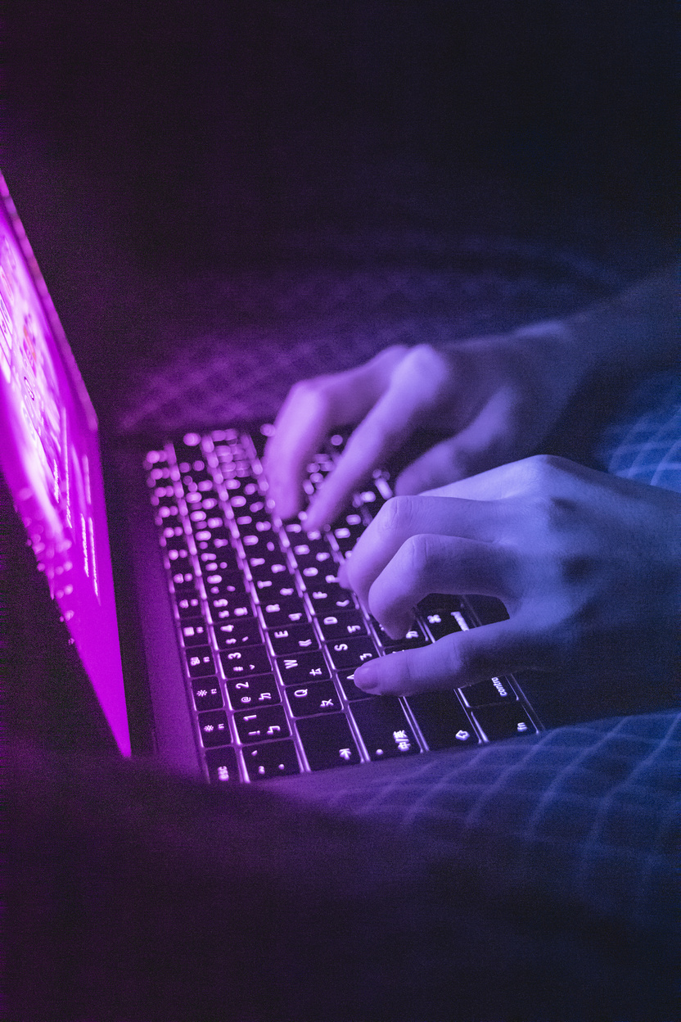

Why Transfer Learning?
• Pretrained on 14 M+ ImageNet images → rich features
• Faster convergence, less data required
• Proven in deepfake literature to boost accuracy 4-6 pp
• Chosen nets: ResNet-18 (classic) & EffNet-B0 (modern efficient)
Slide
14
Notes:
Sufi - Now, why did we switch to transfer learning? The main advantage is that pretrained models already know a lot about general image features because they've learned from huge datasets, like ImageNet, with 14 million images. This means our models don’t need to start learning from scratch.
In practice, using transfer learning helps our model train faster, achieve better accuracy, and perform well even with smaller datasets. Previous research on deepfake detection also shows that fine-tuning pretrained models usually improves accuracy significantly compared to training new models from scratch.
For our project, we chose two pretrained models:
•⁠ ⁠ResNet-18, a classic model widely used in image recognition tasks.
•⁠ ⁠EfficientNet-B0, a newer model designed to deliver high accuracy with fewer parameters.
We tested these models to see how each could boost our detection results.

Slide 15
ResNet-18 (1/2) — Residual Learning
• Residual block: F(x)+x lets gradients skip layers
• Mitigates vanishing gradient, enables deep nets
• 18 conv layers grouped in 4 stages
• ~11.7 M parameters
Slide
15
Notes:
Sufi - ResNet-18 is a neural network designed with special blocks called "residual blocks." The key idea is simple: each block adds the output of some layers x back to the original input. You can think of this as giving the network a shortcut—if learning new features doesn't help, the network can just pass along what it already knows.
This trick, called a "skip connection," makes it easier to train deeper networks by solving common issues like the vanishing gradient problem.
ResNet-18 specifically has 18 convolutional layers and around 11.7 million parameters—making it much bigger and more powerful than our basic CNN. We chose ResNet-18 because its deeper structure and residual connections can detect subtle patterns our simpler model might overlook

Slide 16
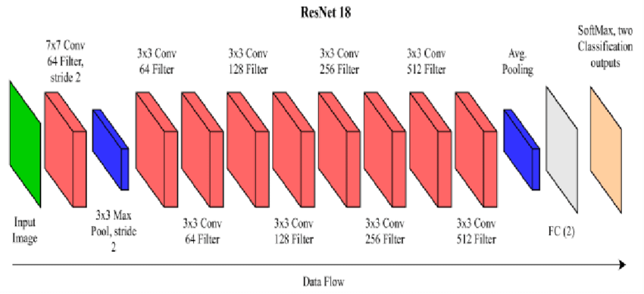
ResNet-18 (2/2) — Fine-Tune Setup
• Freeze first 3 stages (generic features)
• Unfreeze stage 4 + FC head
• LR: 3e-4 (unfrozen) vs 1e-3 (classifier)
• 20 epochs, early-stop at 15
Slide
16
Notes:
Sufi - When fine-tuning ResNet-18, we didn’t retrain the entire model from scratch. Instead, we kept the early layers (first three stages) "frozen," meaning we preserved their pretrained weights. These layers are great at detecting basic features like edges and textures, which apply broadly to most images.
We only "unfroze" the last few layers and the final classification layer, since those are the parts that capture more complex, task-specific patterns for distinguishing AI-generated from human-created images.
To make training smoother, we used different learning rates: a lower one (about 0.0003) for the unfrozen ResNet layers and a slightly higher one (0.001) for the final layer, since it started from scratch.
We planned to train for 20 epochs but used early stopping to avoid unnecessary training. In practice, the model stopped improving around epoch 4, so it didn't even need the full 20 epochs.

Slide 17
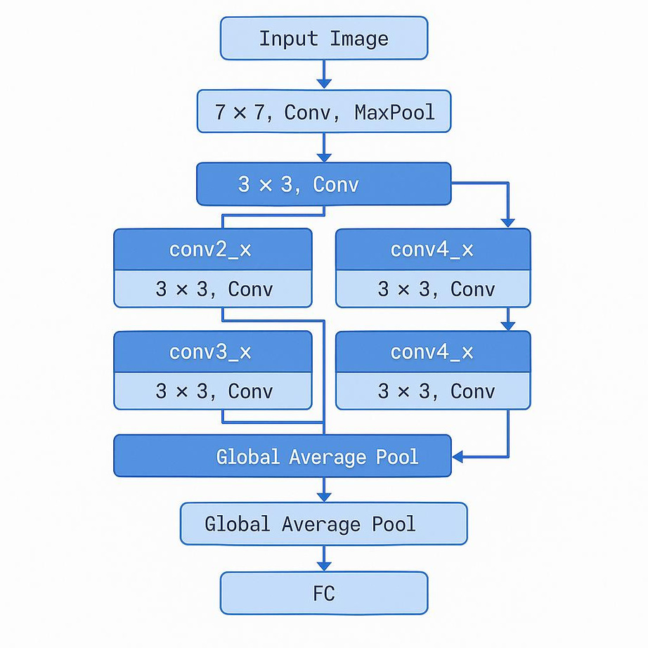
ResNet-18 Results
• Val acc ≈ 98.0 % | F1 0.980
• Errors down
• Balanced FP vs FN
• ROC-AUC 0.99
Slide
17
Notes:
Satya - Now for the ResNet-18 results: our validation accuracy jumped up to about 97.9% with this fine-tuned model (F1 score was 0.98 as well). That’s a huge improvement from 93%. To put it in perspective, instead of 600 mistakes out of 8500 images for our CNN model, ResNet-18 only made around 170 errors on that validation set. We also noticed that it was making balanced errors – it wasn't biased towards calling things fake or real too much. In other words, the number of false positives and false negatives were roughly similar, which is what we want. And the ROC-AUC was about 0.99, indicating extremely good separation between the classes. Overall, ResNet-18 gave us a big boost in accuracy, well above our initial 95% target.

Slide 18
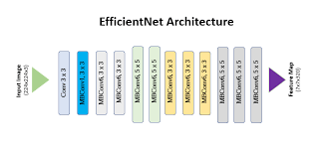
EfficientNet-B0 (1/2) — Compound Scaling
• Balances depth, width, resolution (φ=1)
• Core block: MBConv + Squeeze-Excite attention
• Only 5.3 M params yet ImageNet top-1 77 %
• Ideal for Colab constraints
Slide
18
Notes:
Satya - Next, let's look at EfficientNet-B0. EfficientNet is a family of models known for their compound scaling approach. Instead of just making a network deeper (more layers) or wider (more filters) or using higher resolution images, they scale all three together in a balanced way. EfficientNet-B0 is the baseline model in that family, and it's impressively small: about 5.3 million parameters, yet it achieves roughly 77% top-1 accuracy on ImageNet, which is comparable to much larger models. It uses some modern design tricks to get this efficiency. The main building block is an MBConv (Mobile Inverted Bottleneck Convolution), which is a type of layer that is very parameter-efficient, and it also incorporates Squeeze-and-Excitation units – a lightweight attention mechanism that helps the network focus on important features. Because of its tiny size and good performance, EfficientNet-B0 was great for us working in Colab with limited resources. We expected it to possibly match ResNet-18’s accuracy, but with the benefit of being faster and lighter to train.

Slide 19
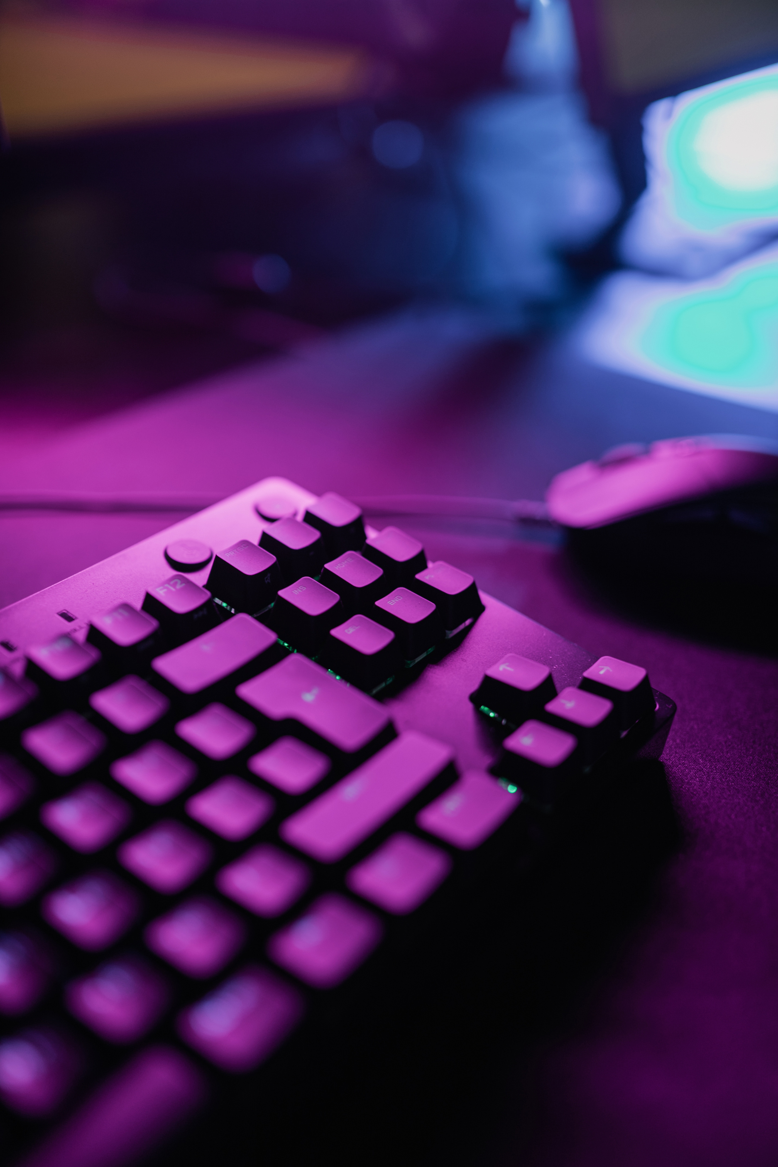
EfficientNet-B0 (2/2) — Fine-Tune Setup
• Freeze to block 5; unfreeze blocks 6-7 + head
• Batch 128 (memory heavier than ResNet)
• LR 2e-4 (backbone) / 1e-3 (head)
• Converged by epoch 14
Slide
19
Notes:
Satya - For fine-tuning EfficientNet-B0, we used a similar approach to ResNet. We froze a large portion of the network – specifically, we kept all layers up to block 5 fixed. Then we unfroze blocks 6 and 7, which are the deeper layers, plus the final classification head. By doing this, we again let the model's higher-level feature detectors adapt to our task while keeping the fundamental feature extractors unchanged. EfficientNet-B0 is small in parameters, but during training it actually used more memory than ResNet (likely due to those extra attention mechanisms), so we had to use a smaller batch size of 128 to avoid running out of memory. We set the learning rate for the unfrozen EfficientNet layers to 2e-4 and for the new head to 1e-3, mirroring the strategy we used for ResNet. The training ran for a similar number of epochs; it converged by about epoch 14, thanks to early stopping once we saw the validation metrics stabilize.

Slide 20
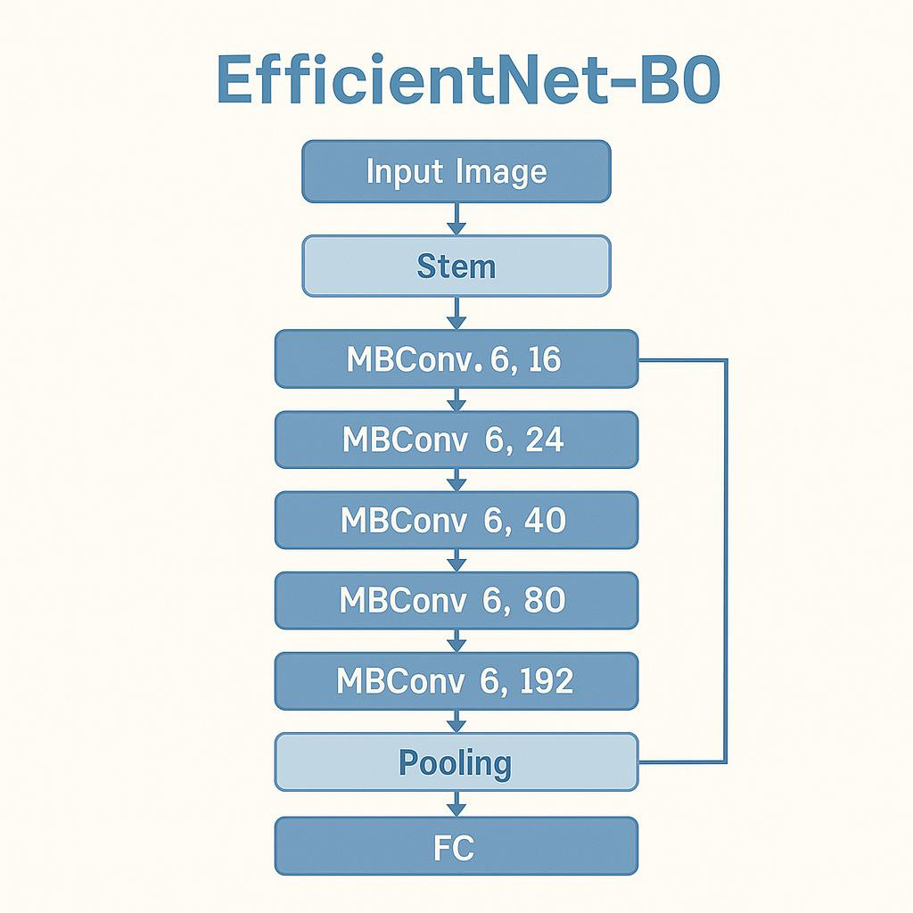
EfficientNet-B0 Results
• Val acc ≈ 98.74 % (best)
• Precision & recall both ≈ 0.987
• Only ~110 mislabels in 8.5 k images
• Slight edge over ResNet despite half the params
Slide
20
Notes:
Satya - Now the EfficientNet-B0 results. This model slightly outperformed ResNet-18 for us. We got about 98.7% validation accuracy, our highest number. In terms of mistakes, out of those ~8500 validation images, it only missed or mislabeled around 110 images, which is even fewer than ResNet's 170 errors. The model’s precision and recall were both approximately 0.987, meaning it was equally good at catching AI images and not raising false alarms on real images. What's notable is EfficientNet achieved this while being about half the size of ResNet in terms of parameters. So not only did we get a tiny boost in accuracy, we did it with a more efficient model. In short, EfficientNet-B0 gave us the best performance and did so with a smaller footprint.

Slide 21
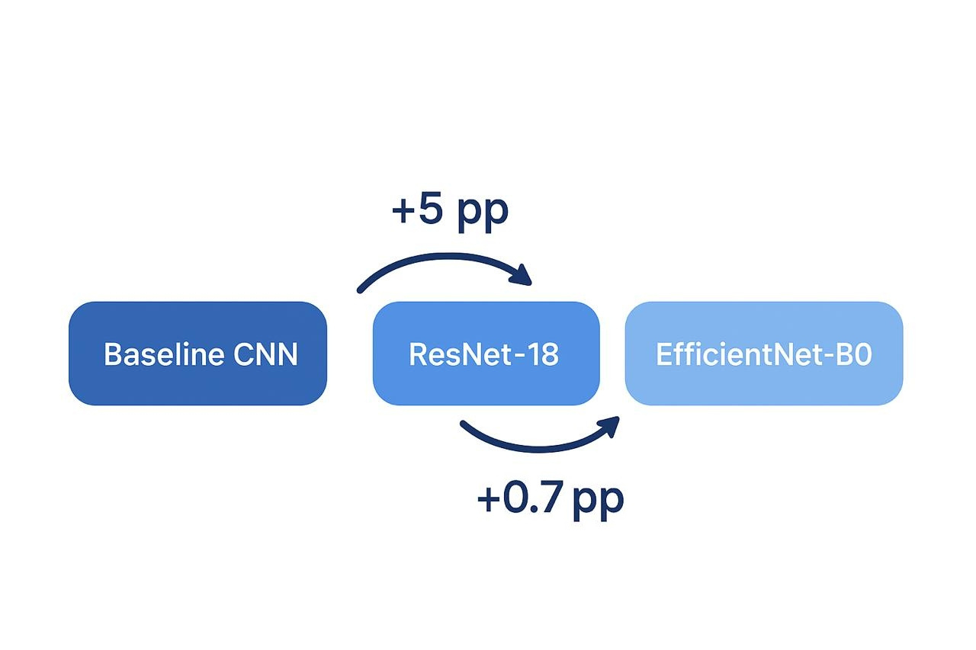
Model Comparison Summary
• Baseline CNN 93.0 %
• ResNet-18 98.0 %
• EfficientNet-B0 98.7 %
• Error rate cut by 3.5× from baseline
• EffNet wins on accuracy-per-parameter efficiency
Slide
21
Notes:
Deven - To compare our models side by side: the baseline CNN got about 93% accuracy, ResNet-18 jumped up to 97.9%, and EfficientNet-B0 topped out at around 98.7%. So each step we took clearly improved performance. In fact, going from 93% to 98.7% means the error rate was cut by roughly a factor of 3.5. EfficientNet-B0 not only had the best accuracy, but if you consider accuracy relative to model size, it was the most efficient as well – it achieved slightly better accuracy than ResNet while using fewer than half the parameters. This summary highlights that using advanced pretrained models was absolutely worth it for our task.

Slide 22
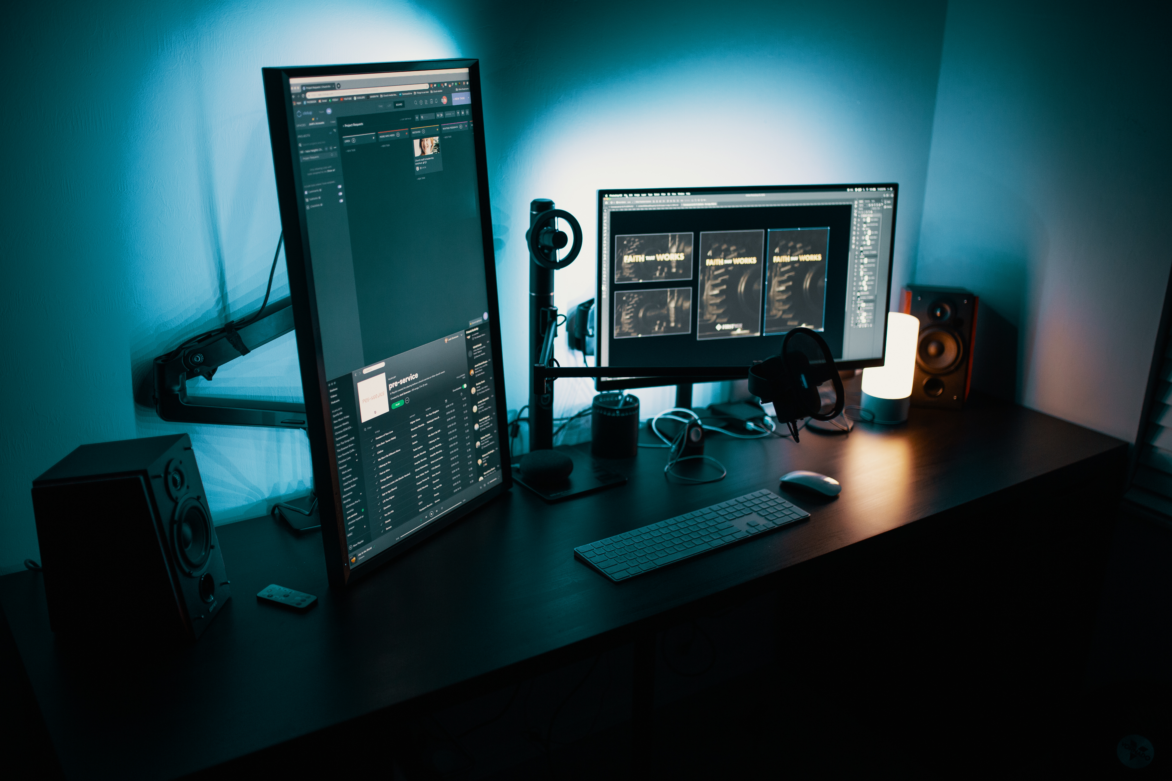
Error Analysis Examples
• False + : artistic real photo mis-flagged as AI
• False − : hyper-real AI render of metal objects
Slide
22
Notes:
Deven - For error analysis, we examined a few mistakes. One false positive was an artistic-style photograph (a real image) that our model incorrectly flagged as AI-generated. Perhaps the photo's surreal look – things like unusual textures or lighting – triggered the model to think it was synthetic. Conversely, a false negative example was an AI-generated image of some metallic objects that was so photo-realistic the model labeled it as real. It simply didn't find anything obviously fake in that image. We also checked attention maps (visualizing what parts of the image the model focused on). We saw that the model often zeroed in on fine texture seams and color edges. Those are the subtle details it uses to tell AI and human images apart, which aligned with what we'd expect – it’s looking for those tiny imperfections or patterns that might betray an AI image.

Slide 23

Challenges Faced
• Free Colab T4 GPU ⇒ limited batch & trials
• Long training times (EffNet ~4 h)
• Hyper-param search kept minimal
• Dataset storage & streaming quirks on Drive
Slide
23
Notes:
Deven - Like any project, we had some challenges. One big issue was the compute limit: we were mainly using a free Colab with a T4 GPU. It's decent but not super fast, and we couldn't run too many experiments without hitting session limits. For instance, training EfficientNet-B0 took around 4 hours, so we had to be selective in our tuning – we couldn't try a massive grid of hyperparameters. We mostly stuck to a few sensible settings to keep time manageable. Another challenge was data handling. Our dataset was on Google Drive, and sometimes loading tens of thousands of images from there can be slow or glitchy. We had to work around those quirks (like ensuring the drive stayed mounted and using efficient data loaders) so that data reading didn't bottleneck our training.

Slide 24
Current Limitations
• Domain-shift risk with future generators
• ~1 % error still non-trivial at web scale
• Real-time inference edge devices needs pruning/quantization
• Model blind to metadata or multimodal cues
Slide
24
Notes:
Deven - Even with high accuracy, our solution has a few limitations. One is generalization to future fakes: we trained on current AI-generated images, but newer generative models might produce images that differ in ways our model wasn't trained on, so we may need to retrain or update the detector over time. Also, a ~1% error rate is not trivial at web scale – if you scan millions of uploads, even 1% misclassifications could be thousands of images. Another limitation is deployment efficiency: our model might be too slow or resource-intensive for real-time use on user devices or large platforms without further optimization (for example, using model pruning or quantization to speed it up). Lastly, our detector only looks at pixel content. It doesn’t use any metadata or cross-modal clues. In reality, combining image analysis with metadata (like camera information) or other context

Slide 25
TL nets push AI-vs-real accuracy to ~99 %
Feasible detector today; must evolve tomorrow
Augmentation & smart freezing critical
Key Takeaways & Q &A
Slide
25
Notes:
Deven - In conclusion, we have two key takeaways. First, building a detector for AI-generated images is feasible today – our project reached around 98–99% accuracy, showing that current deep learning techniques can reliably tell AI images from real ones. But this leads to the caveat that it must evolve in the future as AI image generators become even more advanced. So we can't be complacent; ongoing improvements will be needed to maintain that edge. Second, on the methodology side, the combination of data augmentation and smart transfer learning was crucial for our success. Simple techniques like flipping and rotating images helped our baseline model a lot, and then using pre-trained networks (and fine-tuning them carefully, like freezing and unfreezing the right layers) took the accuracy to the high 90s. Essentially, leveraging those pre-trained transfer learning models is what enabled us to push the AI-vs-real classification accuracy to around 99%. Those are the main points we hope you remember from our work.

Slide 26
THANK YOU
FOR YOUR ATTENTION
Slide
26

